Slide 1
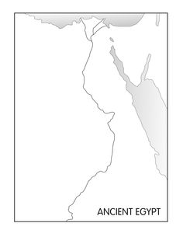
Label the:
Nile River
Red Sea (also color BLUE)
Mediterranean Sea (color BLUE)
Sahara Desert Western Desert
Nile Delta
Giza
Question:
Why were most of the cities located along the Nile River?

Slide 2
Name_______________ Date_____________
Study Guide Chapter 4 Section 1 ONLY
Vocabulary:
Cataract
Delta
Silt
Fertile
Linen
Plateau
Quarried
Irrigation
Short Answer:
What did the arrival of the sacred ibises mean?
What kind of crops did Egyptians grow?
How did Egyptians use the wheat that they grew?
Why was Egypt called the “Gift of the Nile?
Why was it a benefit that the Nile River flooded at the same time each year?
What major benefit did the yearly flooding bring to Egyptian farmers?
What is the difference between “black” land and “red” land?
What were some of the agricultural techniques used by the ancient Egyptians?
Be able to name five activities/jobs of the ancient Egyptians.

